Slide 1

Biometric Attendance system
GROUP NO.10
GROUP MEMBERS STUDENT ID
1.DINESH DESHMUKH 16204005
2.NILESH MOHITE 16204030
3.YASH BHOIR 15104031
4.AKASH BAMNE 16204020
PROJECT GUIDE AND CO-GUIDE
PROF.GANESH GOURSHETE

Slide 2
CONTENT
INTRODUCTION
ABSTRACT
PROPOSED SYSTEM
DESIGN (ARCHITECTURE)
TECHNOLOGY STACK
DEPENDENCIES
PROJECT PLANNING

Slide 3
INTRODUCTION
Biometric based attendance system is a fool proof of technology to ensure the accuracy of attendance & is useful for the colleges students & office employees.
Biometric based attendance system consists of attendance marked digitally using a mobile application.
It is a mobile application which needs to be installed by the students as well as the faculty.
Wifi,OTP,login username & password,fingerprint are the main elements of this application.
Due to this app there is no chances of proxy being marked.

Slide 4
abstract
Attendance tracking and maintaining attendance using traditional approach Is teadious process.
The individual has to maintain attendance record using registers & files using pen & paper, So to make this work is less we have been working on this biometric based attendance system.
In this system with the help of wifi connection & fingerprint scanning attendance will be carried out.
Both the faculty as well as the student should be connected to the same wifi and the session will be created by the faculty as per the lecture & OTP will be generated and sends to every students randomly.
Based on that OTP,students will login and give his/her fingerprint and will be marked attendance.

Slide 5
Proposed system
Earlier paperwork as well as machines were used for marking attendance.
Thus our system is a mobile application,which needs to be installed by the student & faculty on their mobiles.
Session and OTP are the new concepts introduced and added to it,in addition to it have kept biometric authentication through fingerprint.
The only thing needed is that both student & faculty need to be connected to the same wifi,which is the most important while using this system.

Slide 6
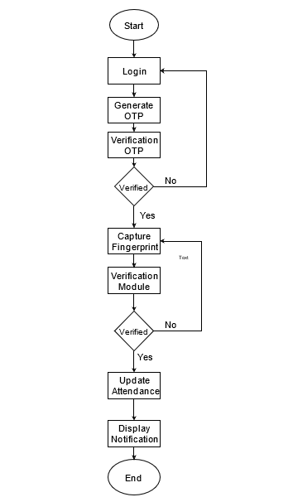
design

Slide 7
DEPENDENCIES
Android phones : having API’s 6.0 or above
Wifi : wifi connection is required for login and mark the attendance

Slide 8
Technology Stack
Tool kit : Android Studio
Design language : java
Database : Mysql

Slide 9
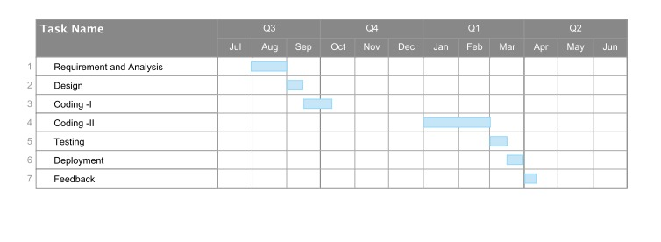
Project planning
Gantt Chart :

Slide 10
Thank you!!!
.

